Slide 1
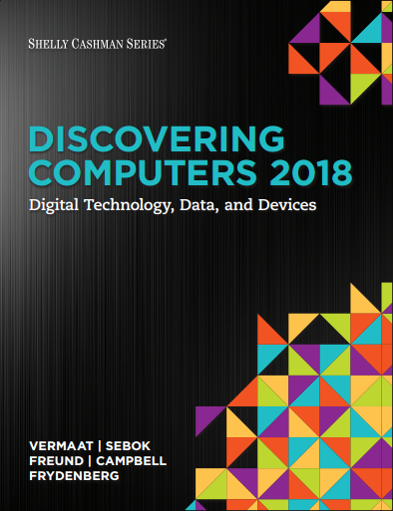

DISCOVERING COMPUTERS 2018 Digital Technology, Data, and Devices
Module 9
Operating Systems: Managing Coordinating, and Monitoring Resources
© 2018 Cengage版權所有，為課本著作之延伸教材，亦受著作權法之規範保護，僅作為授課教學使用，禁止列印、影印、未經授權重製和公開散佈

Slide 2
Objectives Overview (1 of 2)
Explain the purpose of an operating system.
Describe the start-up process and shutdown options on computers and mobile devices.
Explain how an operating system provides a user interface, manages programs, manages memory, and coordinates tasks.
Describe how an operating system enables users to configure devices, establish an Internet connection, and monitor performance.

Slide 3
Objectives Overview (2 of 2)
Identify file management and other tools included with an operating system, along with ways to update operating system software.
Explain how an operating system enables users to control a network or administer security.
Summarize the features of several desktop operating systems.
Briefly describe various server operating systems.
Summarize the features and uses of several mobile operating systems.

Slide 4
OS in technology develope
Release of UNIX (1969)
Personal Computer Proliferation (1980s)
Rise of the Internet (1990s)
Widespread Adoption of Virtualization Technology (2000s)
Mobile Computing Revolution (2007 and beyond)
Cloud computing?

Slide 5
Construction of OS
C/C++
Rust
Shell script
Assembly language
Python……

Slide 6
Construction of OS
C/C++
The vast majority of operating system kernels, such as Linux and Windows, are written in C/C++.
Allow for low-level operations.
Providing direct control over memory and hardware.

Slide 7
Construction of OS
Rust
Memory safety
It can prevent many common memory errors (like buffer overflows) found in C/C++ without sacrificing performance.

Slide 8
Construction of OS
Shell script
NOT used to write the OS kernel.
Instead, it is used to write "tools" and "automation scripts" that surround the operating system. For example, commands that run when the system boots up, file management, or setting up environmental variables.

Slide 9
Construction of OS
Assembly language
The lowest-level language, closest to the computer's hardware.
It is used for very small but extremely critical parts of the OS, such as the "bootloader" or in sections that need to manipulate specific CPU instructions directly.

Slide 10
Construction of OS
Python
Also NOT used to write the OS kernel.
Can do almost everything!
For example, data science, AI, backend development, automation, database manipulation, etc.

Slide 11
Operating Systems (1 of 3)
Start and shut down a computer or mobile device.
Provide a user interface.
Manage programs.
Manage memory.
Coordinate tasks. (Share hardware resources more efficiently)
Configure devices.
Monitor performance.
Establish an Internet connection.

Slide 12
Operating Systems (2 of 3)
Provide file management and other device or media-related tasks.
Updating operating system software.
Control a network.
Administer security.

Slide 13
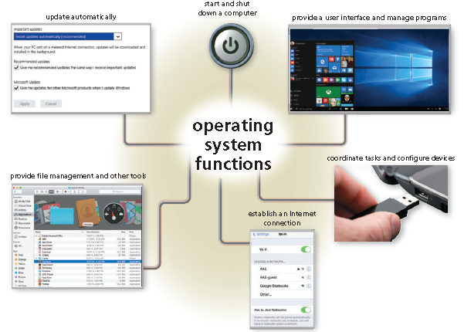
Figure 9-1 Most operating systems perform similar functions.

Slide 14
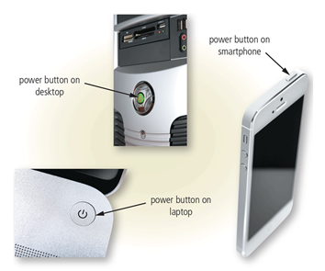
Starting Computers and Mobile Devices
If a computer or mobile device is off, you press a power button to turn it on.
Figure 9-2 Examples of power buttons on computers and mobile devices.

Slide 15
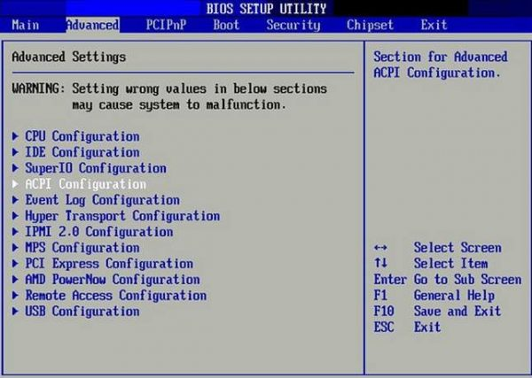
BIOS(Basic Input/Output System)
Written in ROM(Read-Only Memory) or flash memory
Self-test after power on
Allow settings

Slide 16
More about BIOS
We don’t use BIOS nowadays, instead, we use UEFI (Unified Extensible Firmware Interface, 統計可擴展韌體介面)。
BIOS does the following after power-on:
1. POST (Power-On Self-Test)
It "wakes up" and checks all the essential hardware (like the CPU, RAM, and keyboard) to ensure they are working correctly.
2. Locate the OS (Operating System)
It searches your storage drives (like the SSD or HDD) to find the bootloader (the starting program for the OS).

Slide 17
More about BIOS
3. Hand Over Control
Once it finds the bootloader, the BIOS hands over control, and the bootloader begins to load your main operating system (like Windows, macOS, or Linux).
Bootloader:
A bootloader is a small, essential program that runs after the BIOS/UEFI checks your hardware. Its one job is to find your operating system (like Windows or macOS) on the storage drive and load its core (the kernel) into RAM, allowing the OS to take control and start.

Slide 18
Operating System Functions (2 of 19)
An operating system includes various power options
Sleep mode saves any open documents and running programs or apps to RAM, turns off all unneeded functions, and then places the computer in a low-power state
Hibernate mode saves any open documents and running programs or apps to an internal hard drive before removing power from the computer or device

Slide 19
Operating System Functions (3 of 19)
A User Interface (UI) controls how you enter data and instructions and how information is displayed on the screen.
With a Graphical User Interface (GUI), you interact with menus and visual images.

Slide 20
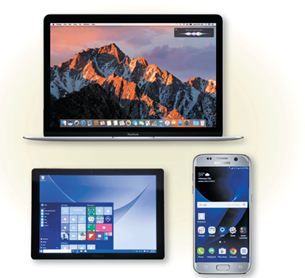
Figure 9-3 Examples of operating system graphical user interfaces on some computers and mobile devices.

Slide 21
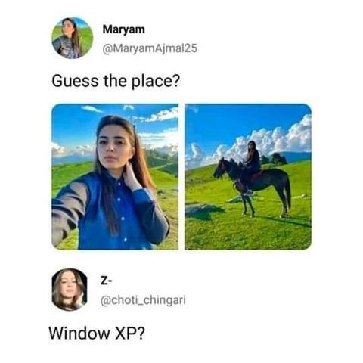
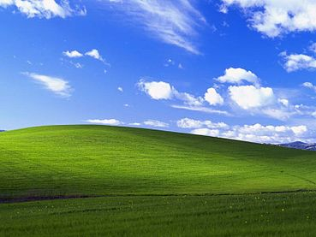
Windows XP
Bliss Wallpaper

Slide 22
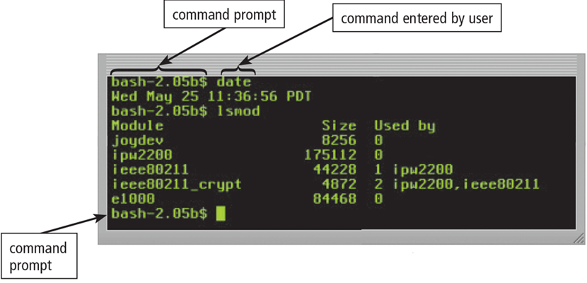
In a command-line interface, a user types commands represented by short keywords or abbreviations or presses special keys on the keyboard to enter data and instructions.
Figure 9-4 A command-line interface requires you to enter exact spelling, form, and punctuation.

Slide 23
Shell (The interface between user and OS kernel)
Bash（Bourne Again Shell)
sh（Bourne Shell）
csh（C Shell）
zsh（Z Shell）
Windows powershell
hardware
kernel
shell

Slide 24
Common Shells You can type “echo $SHELL” in your terminal to see which one your computer use.
sh (Bourne Shell): A very old, original shell; it's the
"grandfather" of shells on Unix systems.
Bash (Bourne Again Shell): The "upgraded version"
of sh, with more powerful features. For a long time, it was
the default shell for almost all Linux systems and macOS.
csh (C Shell): Another type of shell, its syntax style is more
similar to the C programming language.
zsh (Z Shell): A very powerful and feature-rich modern
shell. This is now the default shell on macOS.
Windows powershell: The modern shell for Windows
systems. It is very different from the traditional cmd.exe
(the black command prompt) and is much more powerful,
primarily used by system administrators.

Slide 25
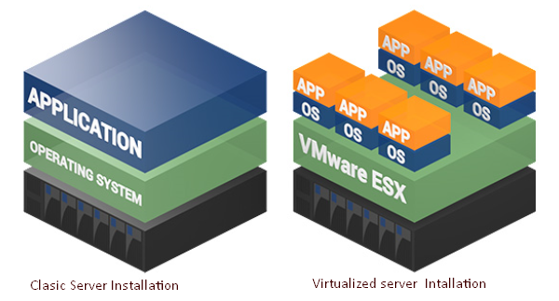
Virtual machine (VM)

Slide 26
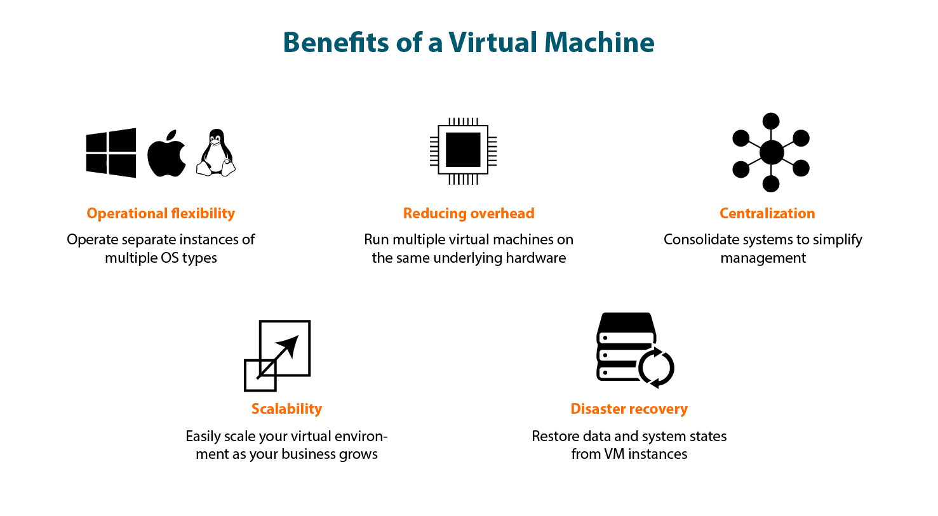
Virtual machine (VM)

Slide 27
Operating System Functions (6 of 19)
How an operating system handles programs directly affects your productivity
Single tasking and multitasking
Foreground and background
Single user and multiuser

Slide 28
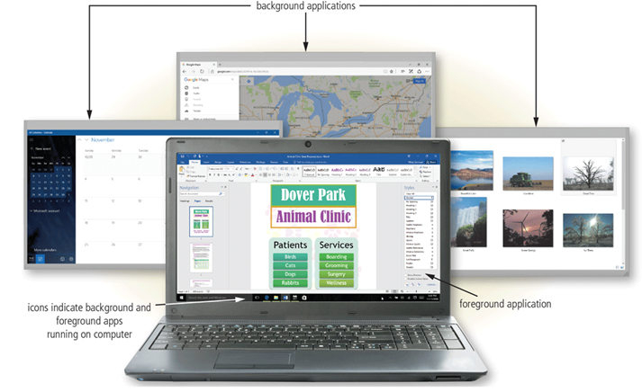
Figure 9-5 The foreground application, Microsoft Word, is displayed on the screen. The other applications (Calendar, Google Maps in Edge, and File Explorer) are in the background.

Slide 29
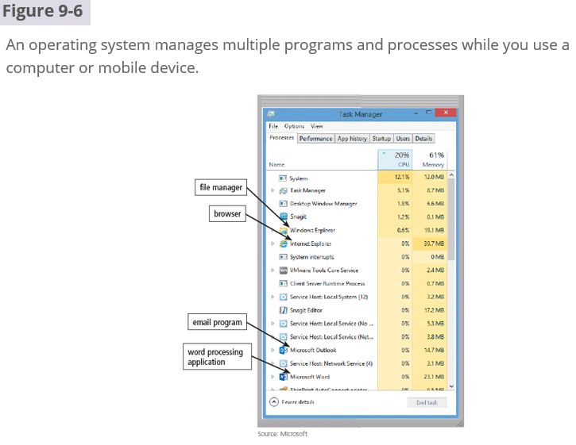

Slide 30
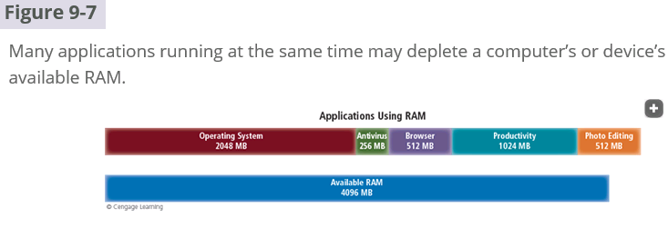
RAM: Random Access Memory

Slide 31
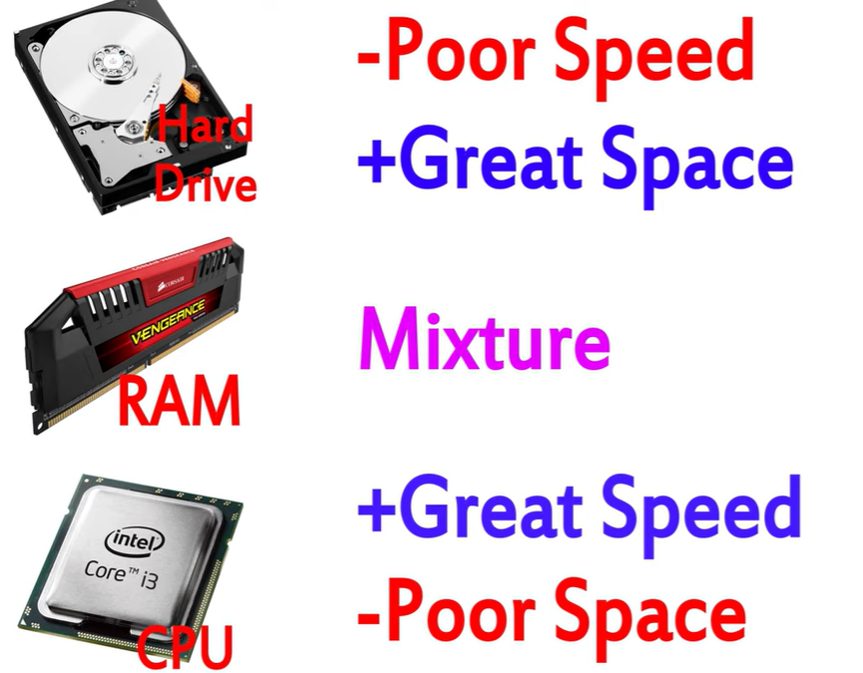
RAM(random access memory)
S(static)RAM
Cache in CPU, fast but expensive
D(dynamic)RAM
Main memory, slow but cheap
& ROM(read only memory)
Reference:
https://www.youtube.com/watch?v=0rNEtAz3wJQ&t=85s

Slide 32
Operating System Functions (8 of 19)
Memory management optimizes the use of the computer or device’s internal memory.
Virtual memory is a portion of a storage medium functioning as additional Random Access Memory (RAM).
Using pages.
The CPU uses Memory Management Unit (MMU) to translate virtual addresses to physical addresses.

Slide 33
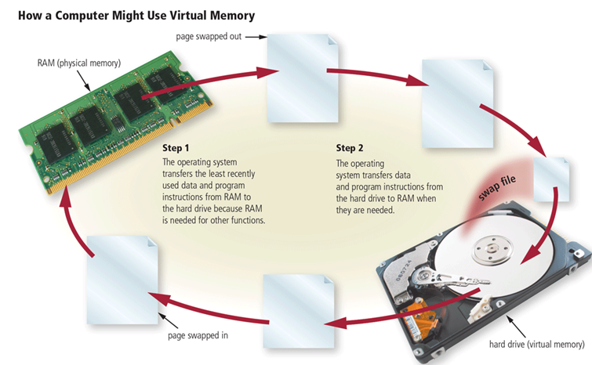
Figure 9-8 This figure shows how a computer might use virtual memory.

Slide 34
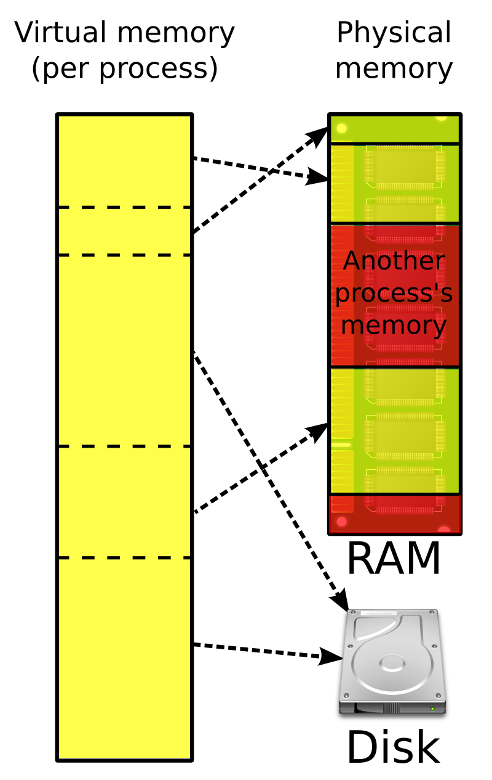
Virtual memory
Multitasking
Convenient management
Memory Fragmentation

Slide 35
Memory Fragmentation
External Fragmentation
External fragmentation is a phenomenon in which storage is wasted because available memory is divided into many small, noncontiguous blocks, none of which is large enough to satisfy a request, even though the total available storage space is theoretically adequate.
Internal Fragmentation
Internal fragmentation is the inability to use allocated memory that is contained within a fixed or variable-size partition or block, but is unused because the amount of memory requested is smaller than the unit allocated.

Slide 36
What are the solutions to external and internal fragmentation?
External Fragmentation
Memory compaction
Paging (so that a process can be stored in various discrete memory )
Internal Fragmentation
Dynamic Partitioning -> May lead to external fragmentation.
Adjusting Block/Page Size -> Page size too small, then page table will be very big.

Slide 37
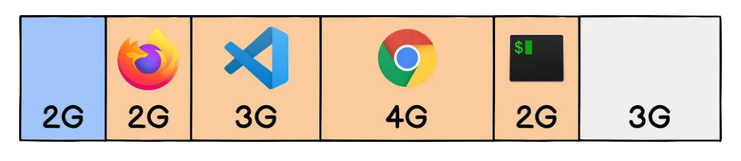
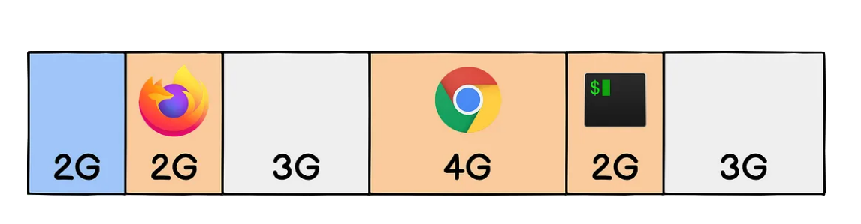
Reference: https://medium.com/starbugs/why-do-os-need-virtual-memory-b47d6eeecbce

Slide 38
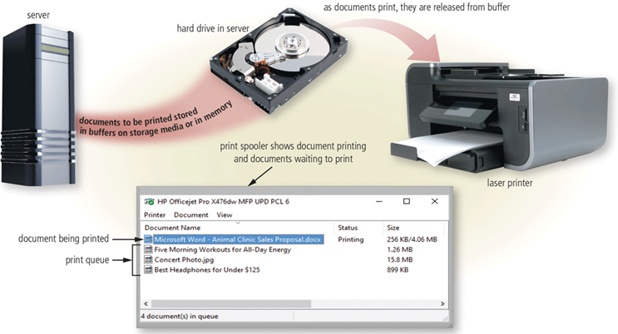
The operating system determines the order in which tasks are processed.
Figure 9-9 Spooling(Simultaneous Peripheral Operations On-Line) increases both processor and printer efficiency by placing documents to be printed in a buffer media before they are printed. This figure shows three documents in the queue with one document printing.

Slide 39
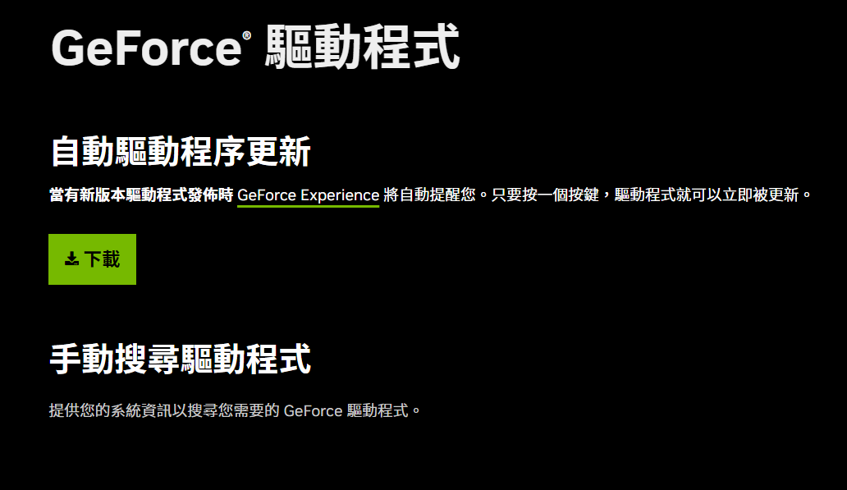
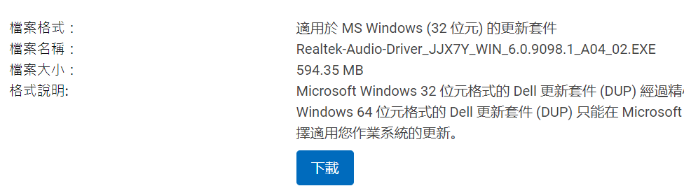
Operating System Functions (11 of 19)
A driver is a small program that tells the operating system how to communicate with a specific device
Plug and Play automatically configures new devices as you install or connect them

Slide 40
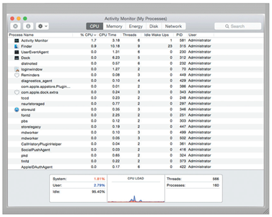
A performance monitor is a program that assesses and reports information about various computer resources and devices.
Figure 9-10 The Activity Monitor in this figure is tracking CPU (Central Processing Unit) usage.
Source: Apple Inc.

Slide 41
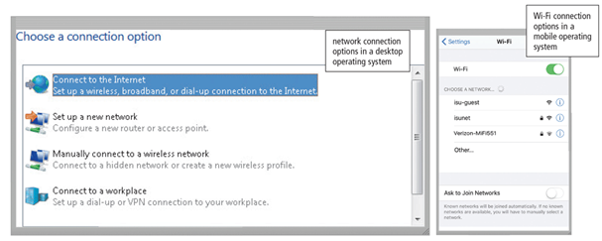
Operating systems typically provide a means to establish Internet connections.
Figure 9-11 Shown here are Internet connection options for desktop and mobile operating systems.

Slide 42
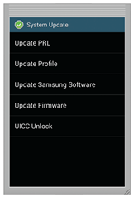
Many programs, including operating systems, include an automatic update feature that regularly provides new features or corrections to the program.
PRL: Preferred Roaming List
UICC: Universal Integrated Circuit Card
SIM: Subscriber Identity Module
Figure 9-12 An operating system usually includes a means to download and install important updates.

Slide 43
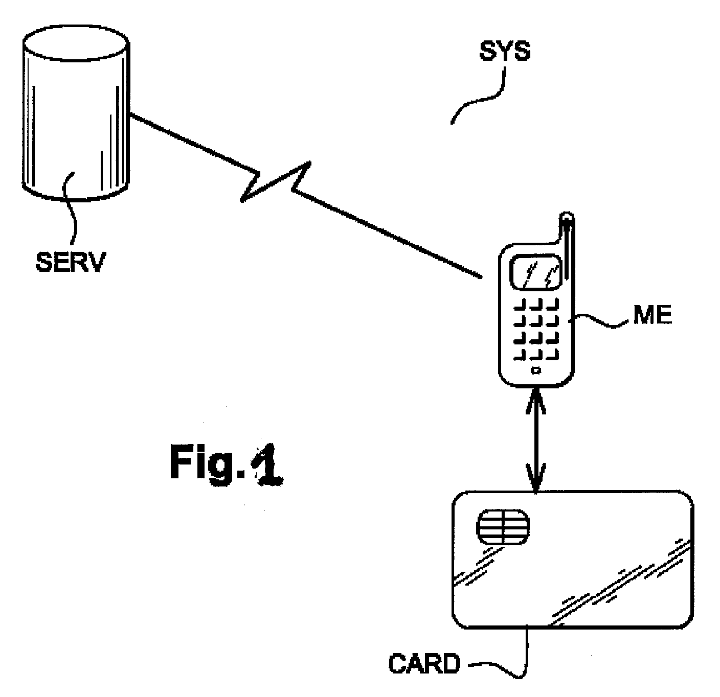
PRL: Preferred Roaming List
A list(database) that indicates which networks advice can connect to.
PRL (預選漫遊列表) 是一個儲存在手機或 SIM 卡中的資料庫，它指示手機在移動或漫遊時，應該優先連接哪些電信網路，以確保通訊的穩定性。

Slide 44
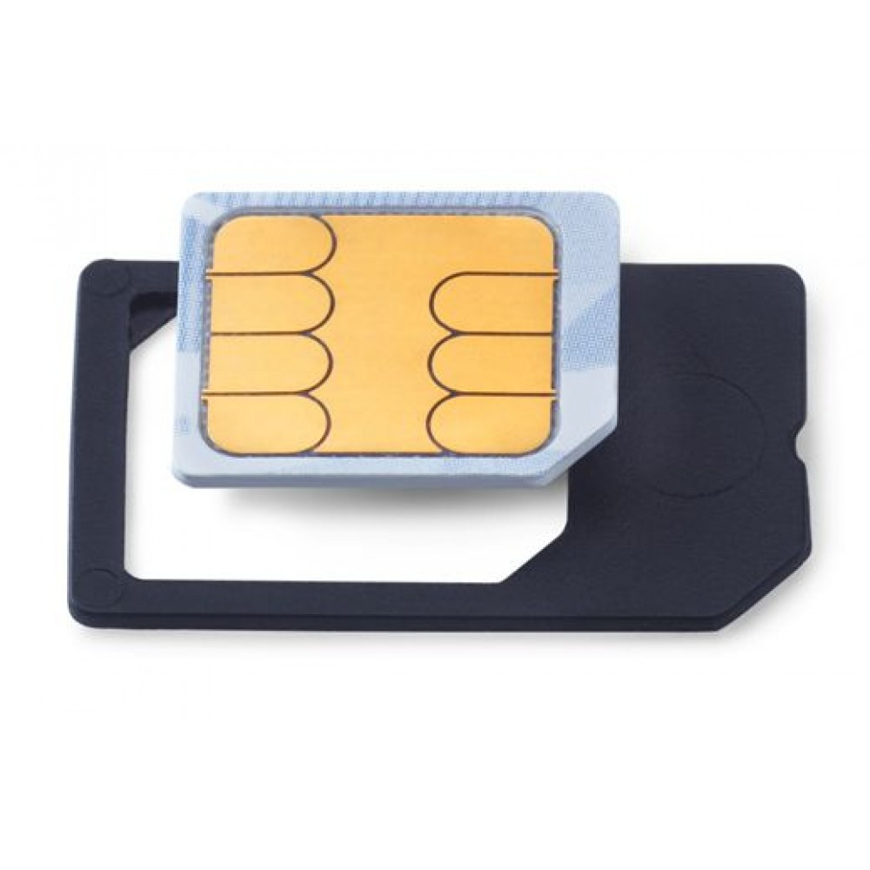
UICC: Universal Integrated Circuit Card 通用積體電路卡
A card that store device information,authentication…to network services.

Slide 45
Operating System Functions (15 of 19)
Operating systems often provide users with a variety of tools related to managing a computer, its devices, or its programs
File Manager
Search
Image Viewer
Uninstaller
Disk Cleanup 磁碟清理
Disk Defragmenter 磁碟重組

Slide 46
Operating System Functions (16 of 19)
Screen Saver
File Compression
Personal Computer (PC) Maintenance
Backup and Restore
Power Management

Slide 47
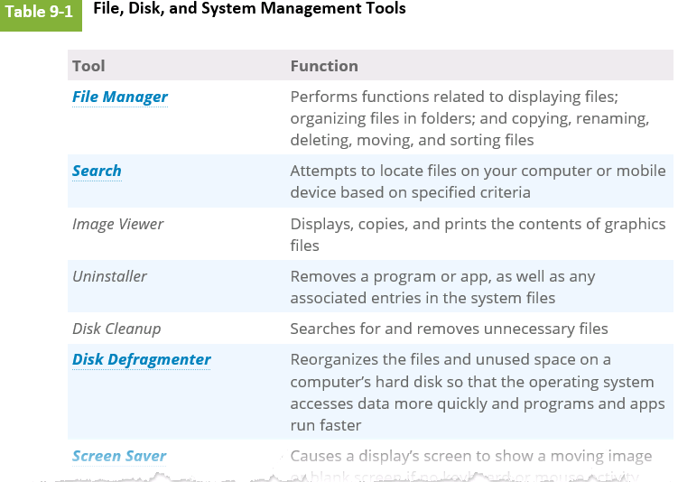

Slide 48
Operating System Functions (17 of 19)
Some operating systems are designed to work with a server on a network
These multiuser operating systems allow multiple users to share a printer, Internet access, files, and programs
A network administrator uses the server operating system to:
Add and remove users, computers, and other devices
Configure the network, install software and administer network security

Slide 49
Operating System Functions (18 of 19)
A user account enables a use to sign in to, or access resources on, a network or computer
A user name, or user ID, identifies a specific user
A password is a private combination of characters associated with the user name

Slide 50
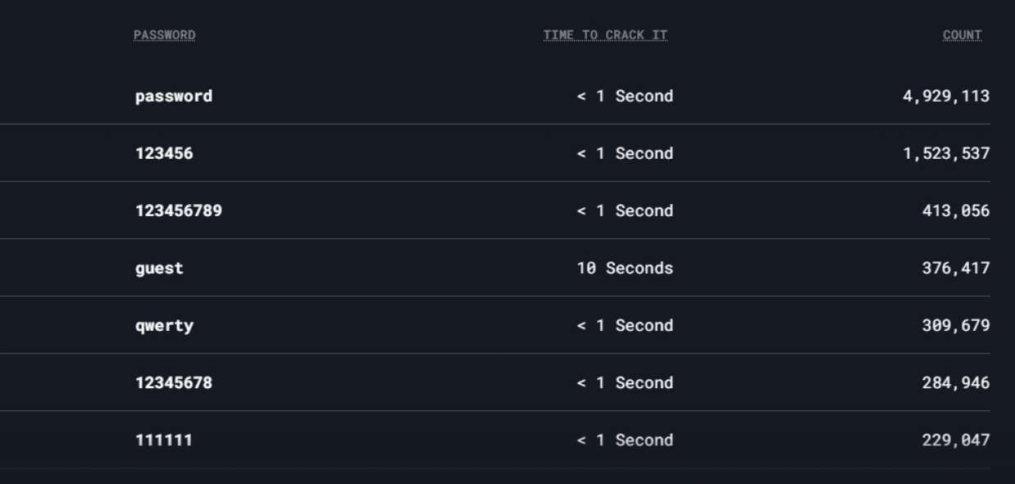
Are those your password?

Slide 51
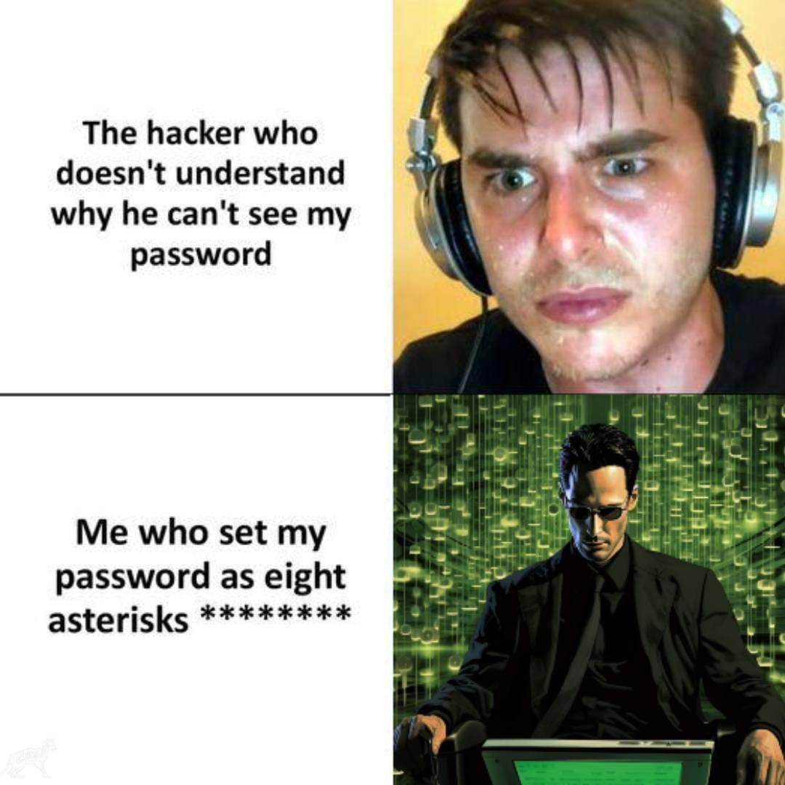

Slide 52
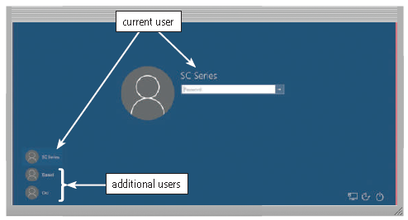
Figure 9-13 Most multiuser operating systems allow each user to sign in, which is the process of entering a user name and a password into the computer. Single-user operating systems often use a password to lock an entire device or computer.

Slide 53
Table 9-2 Examples of Operating Systems (OS) by Category
Category | Name
Desktop | Windows macOS UNIX Linux Chrome OS
Server | Windows Server macOS Server UNIX Linux
Mobile | Google Android Apple iOS Windows (Mobile Edition)

Slide 54
Desktop Operating Systems (1 of 8)
A desktop operating system is a complete operating system that works on desktops, laptops, and some tablets
Windows
macOS
UNIX
Linux
Chrome OS

Slide 55
Desktop Operating Systems (2 of 8)
The latest versions of Windows offer these features
Uses tiles to access apps
Includes the desktop interface
Support for input via touch, mouse, and keyboard
Email app, calendar app, and browser (Edge) included
Photos, files, and settings you can sync with One-Drive
Enhanced security through an antivirus program, firewall, and automatic updates
Windows Store offers additional applications for purchase

Slide 56
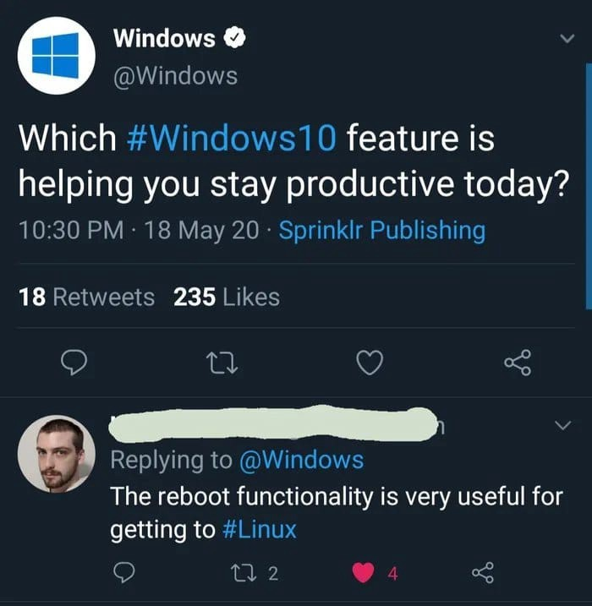

Slide 57
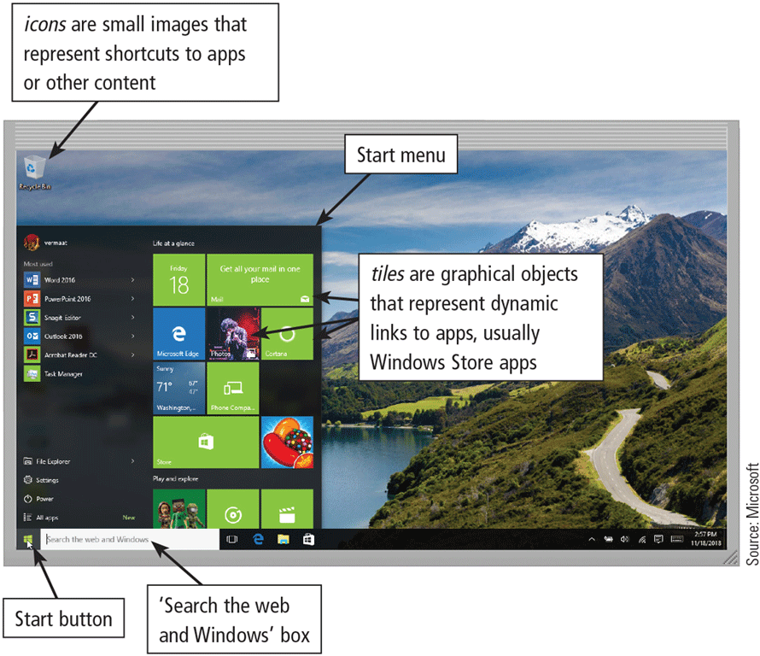

Slide 58
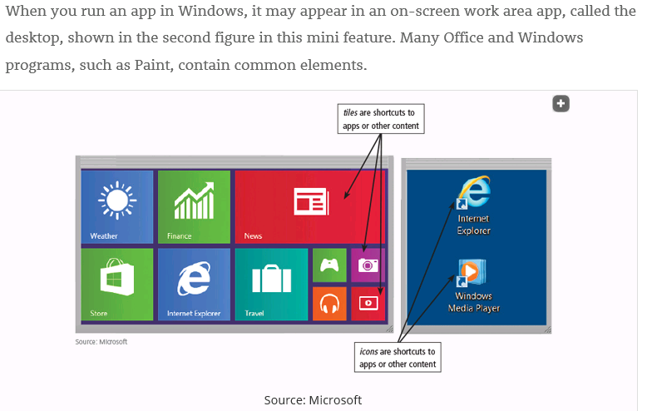

Slide 59
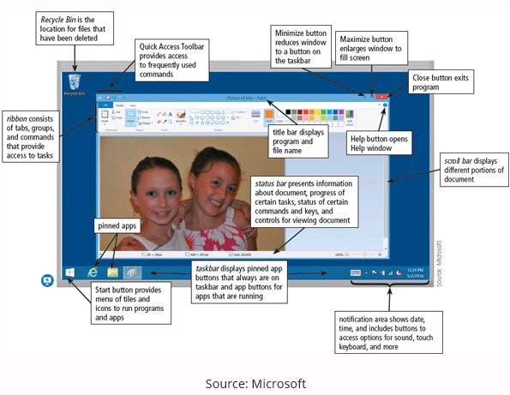
Ribbon 功能帶

Slide 60
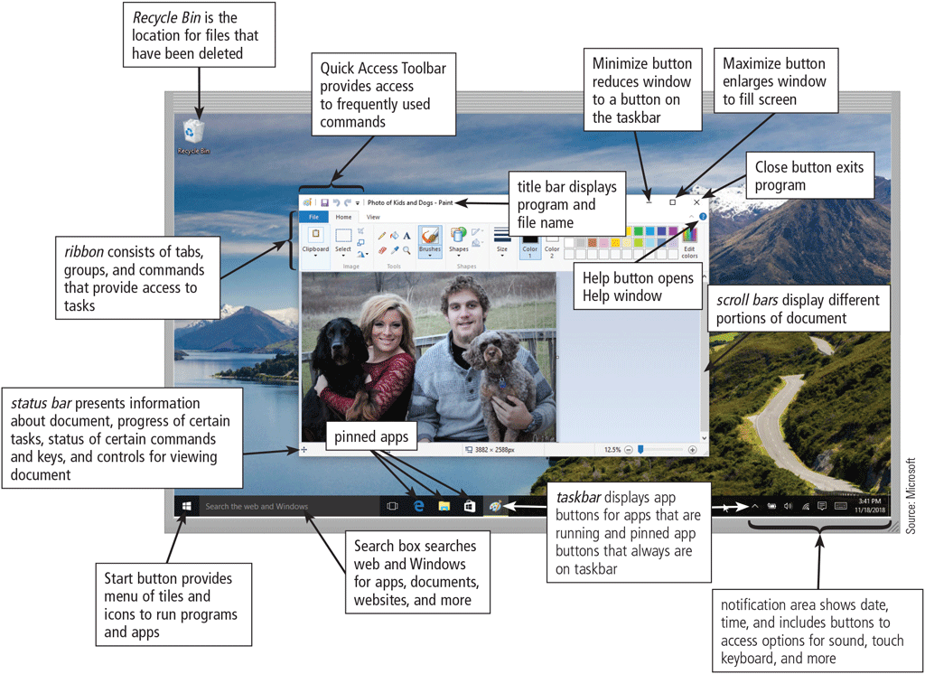

Slide 61
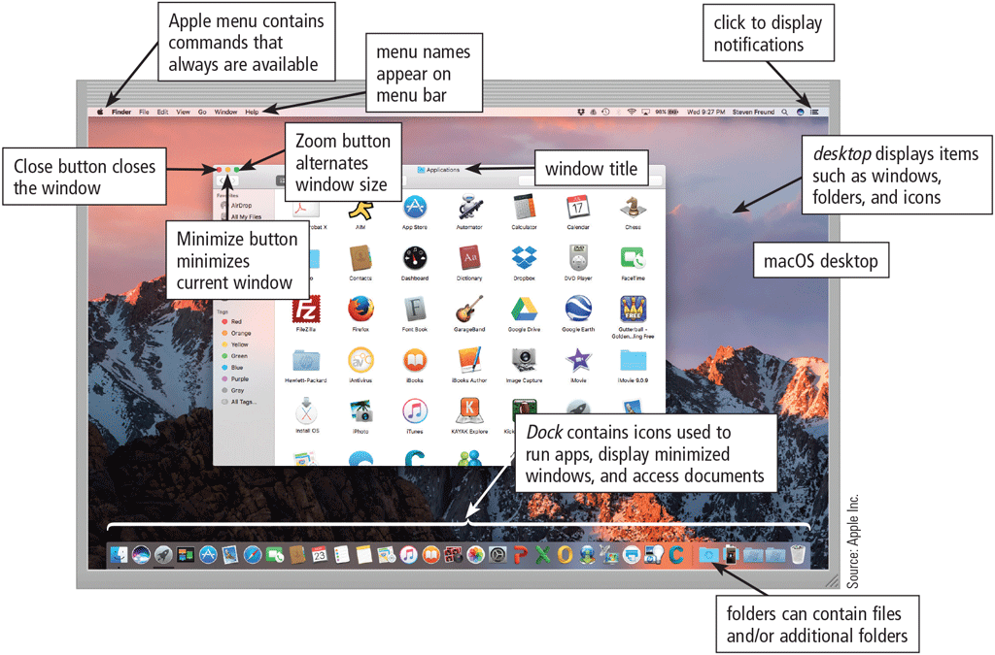
The Macintosh operating system has earned a reputation for its ease of use
macOS

Slide 62
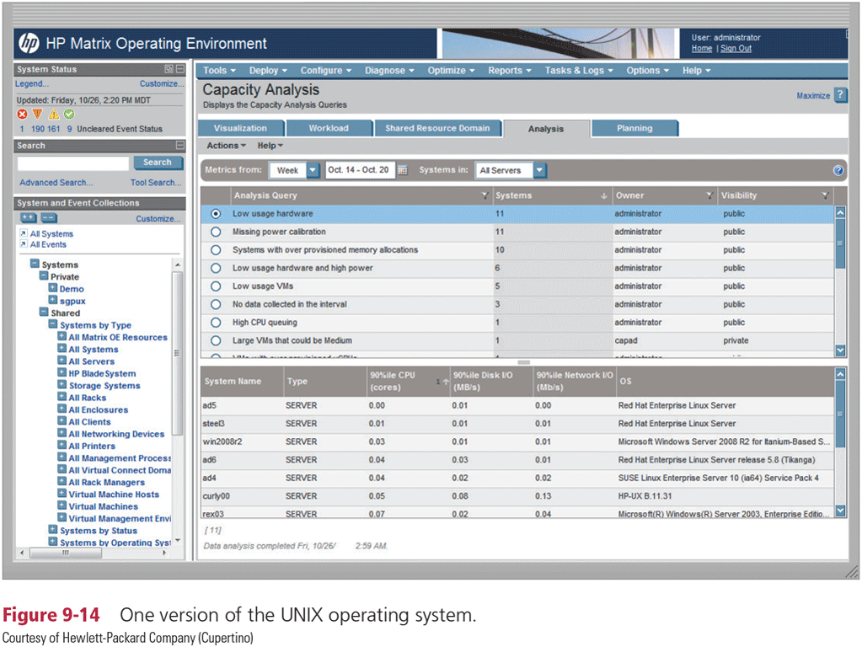
UNIX is a multitasking operating system developed in the early 1970s.

Slide 63
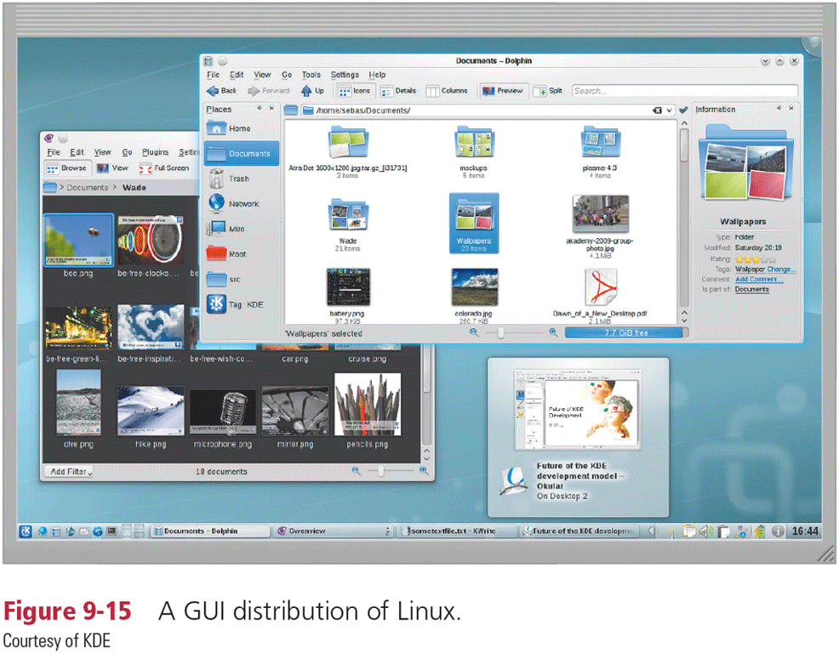
Linux is a popular, multitasking UNIX-based operating system.

Slide 64
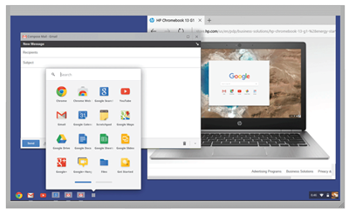
Chrome OS is a Linux-based operating system designed to work primarily with web apps
Figure 9-16 Chrome OS is a Linux-based operating system by Google.

Slide 65
Server Operating Systems
Windows Server
macOS Server
UNIX
Linux

Slide 66
Mobile Operating Systems (slide 1 of 4)
The operating system on mobile devices and many consumer electronics is called a mobile operating system and resides on firmware
Android
iOS
Windows (Mobile Edition)

Slide 67
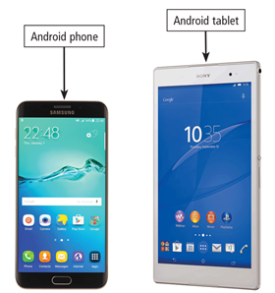
Android is an open source, Linux-based mobile operating system designed by Google for smartphones and tablets.
Figure 9-17 An Android phone and tablet.

Slide 68
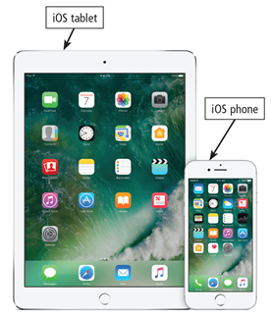
iOS, developed by Apple, is a proprietary mobile operating system specifically made for Apple’s mobile devices.
Figure 9-18 An iOS phone and tablet. Courtesy of Apple Inc.

Slide 69
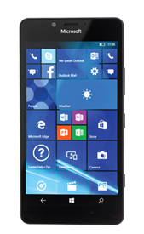
Mobile Operating Systems (4 of 4)
Windows (Mobile Edition), developed by Microsoft, is a proprietary mobile operating system that runs on some smartphones.
Figure 9-19 Phone running Windows (Mobile Edition).

Slide 70
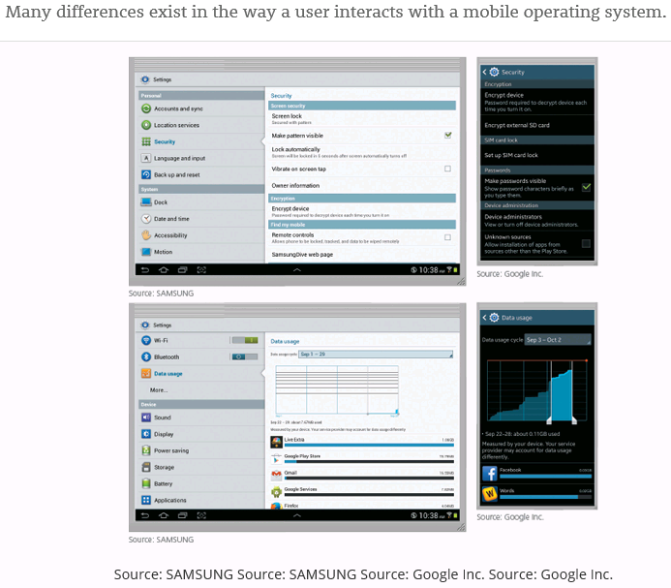

Slide 71
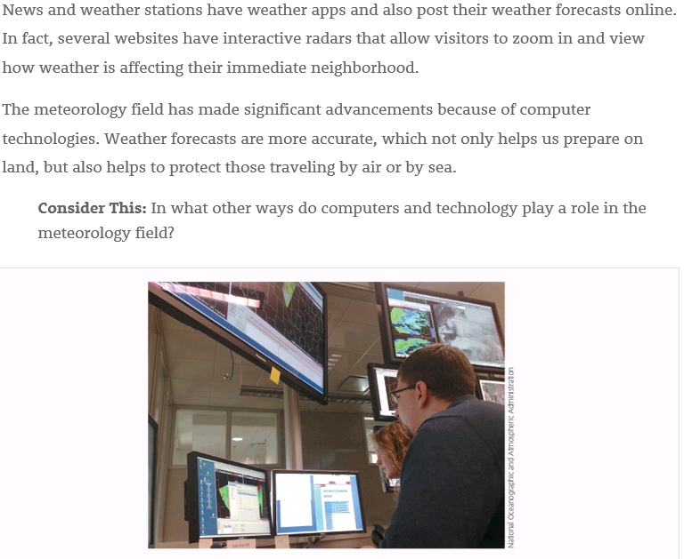
氣象學

Slide 72
Summary
Functions common to most operating systems
Variety of desktop operating systems, server operating systems, and mobile operating systems

Slide 73
Funny Video
https://www.bilibili.com/video/BV1mv411i7wX?vd_source=ce074981029ce1b5ec7b700698648f4c
Starts at 00:39

